Slide 1
How to Build an
Evolutionary Algorithm
EvoNet Flying Circus

Slide 2
The Steps
In order to build an evolutionary algorithm there are a number of steps that we have to perform:
Design a representation
Decide how to initialize a population
Design a way of mapping a genotype to a phenotype
Design a way of evaluating an individual
EvoNet Flying Circus

Slide 3
Further Steps
Design suitable mutation operator(s)
Design suitable recombination operator(s)
Decide how to manage our population
Decide how to select individuals to be parents
Decide how to select individuals to be replaced
Decide when to stop the algorithm
EvoNet Flying Circus

Slide 4
Designing a Representation
We have to come up with a method of representing an individual as a genotype.
There are many ways to do this and the way we choose must be relevant to the problem that we are solving.
When choosing a representation, we have to bear in mind how the genotypes will be evaluated and what the genetic operators might be.
EvoNet Flying Circus

Slide 5
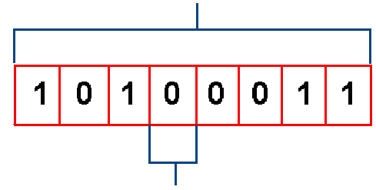
Example: Discrete Representation (Binary alphabet)
Representation of an individual can be using discrete values (binary, integer, or any other system with a discrete set of values).
Following is an example of binary representation.
CHROMOSOME
GENE
EvoNet Flying Circus

Slide 6

Example: Discrete Representation (Binary alphabet)
Phenotype:
8 bits Genotype
Integer
Real Number
Schedule
...
Anything?
EvoNet Flying Circus

Slide 7
Example: Discrete Representation (Binary alphabet)
Phenotype could be integer numbers
Genotype:
Phenotype:
= 163
1*2⁷ + 0*2⁶ + 1*2⁵ + 0*2⁴ + 0*2³ + 0*2² + 1*2¹ + 1*2⁰ =
128 + 32 + 2 + 1 = 163
EvoNet Flying Circus

Slide 8
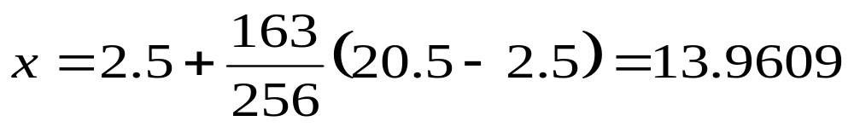
Example: Discrete Representation (Binary alphabet)
Phenotype could be Real Numbers
  e.g. a number between 2.5 and 20.5 using 8 binary digits
Genotype:
Phenotype:
= 13.9609
EvoNet Flying Circus

Slide 9
Example: Discrete Representation (Binary alphabet)
Phenotype could be a Schedule
  e.g. 8 jobs, 2 time steps
Time Step
Job
1
2
3
4
5
6
7
8
2
1
2
1
1
1
2
2
Genotype:
=
Phenotype
EvoNet Flying Circus

Slide 10
Example: Real-valued representation
A very natural encoding if the solution we are looking for is a list of real-valued numbers, then encode it as a list of real-valued numbers! (i.e., not as a string of 1’s and 0’s)
Lots of applications, e.g. parameter optimisation
EvoNet Flying Circus

Slide 11
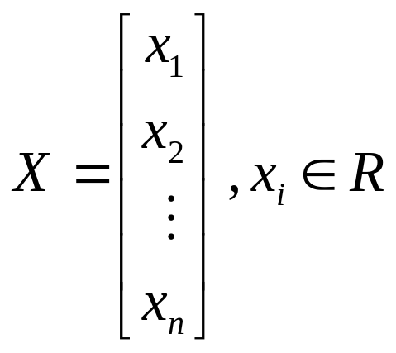
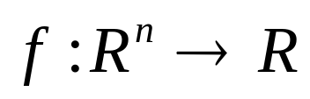
Example: Real valued representation, Representation of individuals
Individuals are represented as a tuple of n real-valued numbers:
The fitness function maps tuples of real numbers to a single real number:
EvoNet Flying Circus

Slide 12
Example: Order based representation
Individuals are represented as permutations
Used for ordering/sequencing problems
Famous example: Travelling Salesman Problem where every city gets a assigned a unique number from 1 to n. A solution could be (5, 4, 2, 1, 3).
Needs special operators to make sure the individuals stay valid permutations.
EvoNet Flying Circus

Slide 13
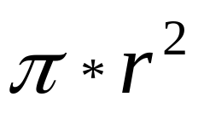
Example: Tree-based representation
Individuals in the population are trees.
Any S-expression can be drawn as a tree of functions and terminals.
These functions and terminals can be anything:
  Functions: sine, cosine, add, sub, and, If-Then-Else, Turn...
  Terminals: X, Y, 0.456, true, false, π, Sensor0…
Example: calculating the area of a circle:
*
π
*
r
r
EvoNet Flying Circus

Slide 14
Example: Tree-based representation, Closure & Sufficiency
We need to specify a function set and a terminal set. It is very desirable that these sets both satisfy closure and sufficiency.
By closure we mean that each of the functions in the function set is able to accept as its arguments any value and data-type that may possible be returned by some other function or terminal.
By sufficient we mean that there should be a solution in the space of all possible programs constructed from the specified function and terminal sets.
EvoNet Flying Circus

Slide 15
Initialization
Uniformly on the search space … if possible
  Binary strings: 0 or 1 with probability 0.5
  Real-valued representations: Uniformly on a given interval (OK for bounded values only)
Seed the population with previous results or those from heuristics. With care:
  Possible loss of genetic diversity
  Possible unrecoverable bias
EvoNet Flying Circus
Notes:
5
Describe the EA that you used, highlighting novelty or application specific details.
This should perhaps include a description of why the particular flavour of EA (ES,EP,GA,GP etc.) was chosen.
How did the representation and algorithm chosen reflect the characteristics of the problem e.g. noisy, long time to evaluate solutions, time-varying fitness function etc.

Slide 16
Evaluating an Individual
This is by far the most costly step for real applications
  do not re-evaluate unmodified individuals
It might be a subroutine, a black-box simulator, or any external process
  (e.g. robot experiment)
You could use approximate fitness - but not for too long
EvoNet Flying Circus

Slide 17
More on Evaluation
Constraint handling - what if the phenotype breaks some constraint of the problem:
  penalize the fitness
  specific evolutionary methods
Multi-objective evolutionary optimization gives a set of compromise solutions
EvoNet Flying Circus

Slide 18
Mutation Operators
We might have one or more mutation operators for our representation.
Some important points are:
At least one mutation operator should allow every part of the search space to be reached
The size of mutation is important and should be controllable.
Mutation should produce valid chromosomes
EvoNet Flying Circus

Slide 19

Example: Mutation for Discrete Representation
1 1 1 1 1 1 1
before
after
1 1 1 0 1 1 1
mutated gene
Mutation usually happens with probability p_{m} for each gene
EvoNet Flying Circus

Slide 20
Example: Mutation for real valued representation
Perturb values by adding some random noise
Often, a Gaussian/normal distribution N(0,σ) is used, where
  0 is the mean value
  σ is the standard deviation
and
x’_{i} = x_{i} + N(0,σ_{i})
for each parameter
EvoNet Flying Circus

Slide 21
Example: Mutation for order based representation (Swap)
Randomly select two different genes and swap them.
7
3
1
8
2
4
6
5
7
3
6
8
2
4
1
5
EvoNet Flying Circus

Slide 22
Example: Mutation for tree based representation
Single point mutation selects one node and replaces it with a similar one.
*
*
2
*
π
*
r
r
r
r
EvoNet Flying Circus

Slide 23
Recombination Operators
We might have one or more recombination operators for our representation.
Some important points are:
The child should inherit something from each parent. If this is not the case then the operator is a copy operator.
The recombination operator should be designed in conjunction with the representation so that recombination is not always catastrophic
Recombination should produce valid chromosomes
EvoNet Flying Circus

Slide 24




Example: Recombination for Discrete Representation
. . .
Whole Population:
Each chromosome is cut into n pieces which are recombined. (Example for n=1)
cut
cut
1 1 1 1 1 1 1
0 0 0 0 0 0 0
parents
1 1 1 0 0 0 0
0 0 0 1 1 1 1
offspring
EvoNet Flying Circus

Slide 25
Example: Recombination for real valued representation
Discrete recombination (uniform crossover): given two parents one child is created as follows
a
b
c
d
e
f
g
h
a
b
C
d
E
f
g
H
A
B
C
D
E
F
G
H
EvoNet Flying Circus

Slide 26
Example: Recombination for real valued representation
Intermediate recombination (arithmetic crossover): given two parents one child is created as follows
a
b
c
d
e
f
A
B
C
D
E
F
↓
(a+A)/2
(b+B)/2
(c+C)/2
(d+D)/2
(e+E)/2
(f+F)/2
EvoNet Flying Circus

Slide 27
Example: Recombination for order based representation (Order1)
Choose an arbitrary part from the first parent and copy this to the first child
Copy the remaining genes that are not in the copied part to the first child:
  starting right from the cut point of the copied part
  using the order of genes from the second parent
  wrapping around at the end of the chromosome
Repeat this process with the parent roles reversed
EvoNet Flying Circus

Slide 28
Example: Recombination for order based representation (Order1)
Parent 1
Parent 2
7
3
1
8
2
4
6
5
4
3
2
8
6
7
1
5
7, 3, 4, 6, 5
order
1
8
2
4, 3, 6, 7, 5
Child 1
7
5
1
8
2
4
3
6
EvoNet Flying Circus

Slide 29
Example: Recombination for tree-based representation
*
2 * (r * r )
2
*
r
r
*
π
+
π * (r + (l / r))
r
/
Two sub-trees are selected for swapping.
1
r
EvoNet Flying Circus

Slide 30
Example: Recombination for tree-based representation
*
*
π
+
π
*
r
/
r
r
*
1
r
2
*
+
2
*
r
/
Resulting in 2 new expressions
r
r
1
r
EvoNet Flying Circus

Slide 31
Selection Strategy
We want to have some way to ensure that better individuals have a better chance of being parents than less good individuals.
This will give us selection pressure which will drive the population forward.
We have to be careful to give less good individuals at least some chance of being parents - they may include some useful genetic material.
EvoNet Flying Circus

Slide 32
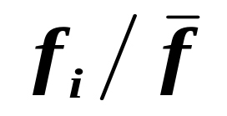
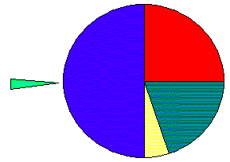
Example: Fitness proportionate selection
Expected number of times f_{i} is selected for mating is:
Better (fitter) individuals have:
  more space
  more chances to be selected
Best
Worst
EvoNet Flying Circus

Slide 33
Example: Fitness proportionate selection
Disadvantages:
Danger of premature convergence because outstanding individuals take over the entire population very quickly
Low selection pressure when fitness values are near each other
Behaves differently on transposed versions of the same function
EvoNet Flying Circus

Slide 34
Example: Fitness proportionate selection
Fitness scaling: A cure for FPS
Start with the raw fitness function f.
Standardise to ensure:
  Lower fitness is better fitness.
  Optimal fitness equals to 0.
Adjust to ensure:
  Fitness ranges from 0 to 1.
Normalise to ensure:
  The sum of the fitness values equals to 1.
EvoNet Flying Circus

Slide 35
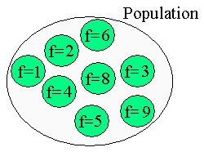
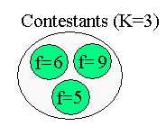
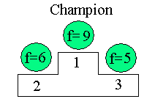
Example: Tournament selection
Select k random individuals, without replacement
Take the best
  k is called the size of the tournament
EvoNet Flying Circus

Slide 36
Example: Ranked based selection
Individuals are sorted on their fitness value from best to worse. The place in this sorted list is called rank.
Instead of using the fitness value of an individual, the rank is used by a function to select individuals from this sorted list. The function is biased towards individuals with a high rank (= good fitness).
EvoNet Flying Circus

Slide 37
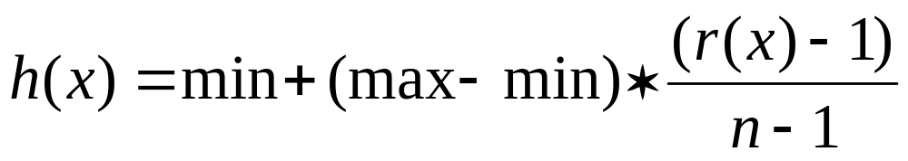
Example: Ranked based selection
Fitness: f(A) = 5, f(B) = 2, f(C) = 19
Rank: r(A) = 2, r(B) = 3, r(C) = 1
Function: h(A) = 3, h(B) = 5, h(C) = 1
Proportion on the roulette wheel:
  p(A) = 11.1%, p(B) = 33.3%, p(C) = 55.6%
EvoNet Flying Circus

Slide 38
Replacement Strategy
The selection pressure is also affected by the way in which we decide which members of the population to kill in order to make way for our new individuals.
We can use the stochastic selection methods in reverse, or there are some deterministic replacement strategies. Alternatively, many approaches create the next generation from the scratch --- in this approach an individual dies unless it is copied into the new population.
EvoNet Flying Circus

Slide 39
Elitism
Should fitness constantly improve?
  Re-introduce in the population previous best-so-far (elitism) or
  Keep best-so-far in a safe place (preservation)
EvoNet Flying Circus
Notes:
2
If the work was done with a collaborating industrial partner, then mention them at this stage, and explain how the problem that was tackled fits into their business.
Describe the general problem here. Was the aim to solve a new problem, or to attempt to find better solutions than could be found by other methods.
Is this a simple optimisation problem or is it desirable to find multiple solutions and present alternatives to the user.

Slide 40
Recombination vs Mutation
Recombination
  modifications depend on the whole population
  decreasing effects with convergence
  exploitation operator
Mutation
  mandatory to escape local optima
  strong causality principle
  exploration operator
EvoNet Flying Circus
Notes:
3
More detailed explanation of the actual problem tackled by the EA.
Is the problem static or dynamic?
Is the evaluation function subjective ? or noisy ?
The more diagrams or pictures here the better - show how the EA search works within the context of the application area

Slide 41
Stopping criterion
The optimum is reached!
Limit on CPU resources: Maximum number of fitness evaluations
Limit on the user’s patience: After some generations without improvement
EvoNet Flying Circus
Notes:
6
Describe how you chose to represent the problem to your algorithm
How was the particular representation chosen e.g.. ordering of bits, gray coding, etc. etc. chosen, and what alternatives were evaluated.
What were the expected benefits of the proposed scheme?
e.g.. smaller search space
infeasible solutions avoided
etc.., etc..
The introductory slides show very basic forms of 1 point crossover and point mutation, so it may be necessary to have a slide for each of the operators you used, showing how they work.

Slide 42
Algorithm performance
Never draw any conclusion from a single run
  use statistical measures (averages, medians)
  from a sufficient number of independent runs
From the application point of view
  design perspective:
    find a very good solution at least once
  production perspective:
    find a good solution at almost every run
EvoNet Flying Circus
Notes:
3
More detailed explanation of the actual problem tackled by the EA.
Is the problem static or dynamic?
Is the evaluation function subjective ? or noisy ?
The more diagrams or pictures here the better - show how the EA search works within the context of the application area

Slide 43
Algorithm Performance (2)
Remember the WYTIWYG principal:
“What you test is what you get” - don´t tune algorithm performance on toy data and expect it to work with real data.
EvoNet Flying Circus

Slide 44
Key Issues
Genetic diversity
  differences of genetic characteristics in the population
  loss of genetic diversity = all individuals in the population look alike
  snowball effect
  convergence to the nearest local optimum
  in practice, it is irreversible
EvoNet Flying Circus
Notes:
4
Elaborate on the potential benefits of using EA based approaches as opposed to other algorithms, especially as opposed to what was being used before.
relate this to the characteristics noted above if possible

Slide 45
Key Issues (2)
Exploration vs Exploitation
  Exploration =sample unknown regions
  Too much exporation = random search, no convergence
  Exploitation = try to improve the best-so-far individuals
  Too much expoitation = local search only … convergence to a local optimum
EvoNet Flying Circus
Notes:
4
Elaborate on the potential benefits of using EA based approaches as opposed to other algorithms, especially as opposed to what was being used before.
relate this to the characteristics noted above if possible

